Slide 1
Monthly Sample Size Prediction of the Current Population Survey
John Jones, Tim Trudell, Brian Shaffer
Views expressed in this paper are those of the authors and do not reflect the views or policies of the U.S. Census Bureau or the Bureau of Labor Statistics

Slide 2
BACKGROUND
The CPS sample size fluctuates from month to month
We identify factors influencing that fluctuation
We use those factors to PREDICT the sample size
We use these predictions to keep stakeholders informed and to plan maintenance reductions

Slide 3
Outline
I. CPS INTRODUCTION
  SAMPLE DESIGN
  ROTATION CHART
II. ELEMENTS DETERMINING CPS SAMPLE SIZE
  DATABASE LOAD
  MAF ADDS
  ATTRITION
III. PREDICTION OF CPS SAMPLE SIZE
IV. COMPARING PREDICTED SAMPLE SIZE TO ACTUAL SAMPLE SIZE
V. RESULTS & CONCLUSIONS

Slide 4
Current Population Survey (CPS)
Sample Design
Two staged Stratified Sample; sampling done on an annual basis
The Frame is the Master Address File (MAF)
MAF is clustered into Primary Sampling Units (PSUs) (think counties)
First stage: Metropolitan PSUs chosen with certainty, and a stratified sample of non metro PSUs are chosen
Second stage: Systematic sample of housing units within PSUs

Slide 5
CPS Sample Design (cont)
Sample divided into rotation groups (panels)
A given panel is in sample 4 consecutive months, out of sample the next 8 months and back in for 4 months
Each month has 8 panels in sample; each panel is in a unique month in sample

Slide 6
Rotation Chart

Slide 7
Factors affecting CPS sample size
Annual Database Load – Sample size at time of Annual Sample
Added housing units (HUs) from the Master Address File (MAF ADDS)
Attrition due to ineligible HUs (Type C noninterviews)
Attrition due to planned sample reduction

Slide 8
Database Load
This is the initial sample chosen before the growth in the frame and approximately a year before going out to interview.
The number of addresses loaded to the database is less than the target because we expect the sample size to increase due to growth in the frame.

Slide 9
ADDITIONS TO FRAME-(MAF ADDS)
Annual sample chosen in March, Interviews begin in April of following year
Each year, the Census Bureau processes 2 updates to the MAF (frame): once in March & once in September
Due to the systematic sample design, the CPS sample grows
The CPS adds this new growth to the sample before the 1st interview (MIS 1) & before the 5th interview (MIS 5)

Slide 10
Annual Sample Schedule
Year | Month | Activity | A | B | C | D | E | F | G | H | I | J | K | L
 | Mar | SAMPLE SELECTION
1 | May | LOAD SAMPLE INTO DATABASE
 | Sep | M1 : ADDITION TO FRAME
 | Jan
 | Feb
 | Mar | M2 : ADDITION TO FRAME
 | Apr |  | 1
 | May |  | 2 | 1
2 | Jun |  | 3 | 2 | 1
 | Jul |  | 4 | 3 | 2 | 1
 | Aug |  |  | 4 | 3 | 2 | 1
 | Sep | M3 : ADDITION |  |  | 4 | 3 | 2 | 1
 | Oct | TO FRAME |  |  |  | 4 | 3 | 2 | 1
 | Nov |  |  |  |  |  | 4 | 3 | 2 | 1
 | Dec |  |  |  |  |  |  | 4 | 3 | 2 | 1
 | Jan |  |  |  |  |  |  |  | 4 | 3 | 2 | 1
 | Feb |  |  |  |  |  |  |  |  | 4 | 3 | 2 | 1
 | Mar | M4 : ADDITION TO FRAME |  |  |  |  |  |  |  |  | 4 | 3 | 2 | 1
 | Apr |  | 5 |  |  |  |  |  |  |  |  | 4 | 3 | 2
 | May |  | 6 | 5 |  |  |  |  |  |  |  |  | 4 | 3
3 | Jun |  | 7 | 6 | 5 |  |  |  |  |  |  |  |  | 4
 | Jul |  | 8 | 7 | 6 | 5
 | Aug |  |  | 8 | 7 | 6 | 5
 | Sep | M5 : ADDITION |  |  | 8 | 7 | 6 | 5
 | Oct | TO FRAME |  |  |  | 8 | 7 | 6 | 5
 | Nov |  |  |  |  |  | 8 | 7 | 6 | 5
 | Dec |  |  |  |  |  |  | 8 | 7 | 6 | 5
 | Jan |  |  |  |  |  |  |  | 8 | 7 | 6 | 5
 | Feb |  |  |  |  |  |  |  |  | 8 | 7 | 6 | 5
4 | Mar | M6 : ADDITION TO FRAME |  |  |  |  |  |  |  |  | 8 | 7 | 6 | 5
 | Apr |  |  |  |  |  |  |  |  |  |  | 8 | 7 | 6
 | May |  |  |  |  |  |  |  |  |  |  |  | 8 | 7
 | Jun |  |  |  |  |  |  |  |  |  |  |  |  | 8

Slide 11
MAF ADDS
Panels with first interview in April through September:
  Have 2 MAF frame updates prior to the first interview (MIS 1)
  Estimate a 1.1% MIS 1 growth in sample
Panels with first interview in October through March:
  Have 3 MAF frame updates prior to the first interview (MIS 1)
  Estimate a 1.7% MIS 1 growth in sample
Estimate a 1.2% MIS 5 growth in sample

Slide 12
Attrition due to Type C non interviews
Type C non interviews are units that are found to be condemned, demolished, or converted to a business. They are subsequently removed from the CPS sample because they are ineligible for interview.
For a given panel, type C noninterviews are identified in every month in sample, but the majority are identified in the first (MIS 1) and fifth (MIS 5) months in sample

Slide 13
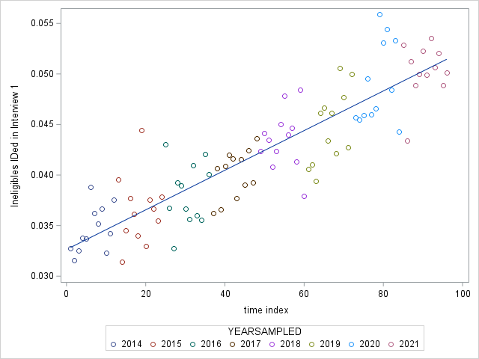
Motivation for Modeling Type C noninterviews
A SCATTERPLOT of INTERVIEW 1 TYPE C NONINTERVIEWS versus TIME
THE Y AXIS IS THE PROPORTION OF LOADED SAMPLE THAT ARE INTERVIEW 1 TYPE Cs
THE X AXIS ARE THE NUMBER OF MONTHS SINCE APRIL 2014

Slide 14
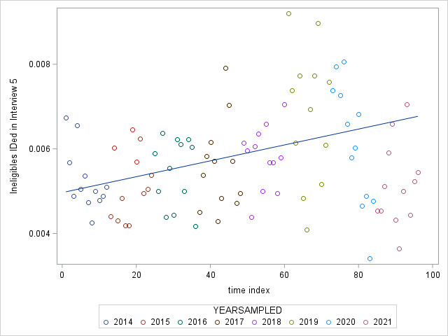
Motivation for Modeling Type C noninterviews
A SCATTERPLOT OF INTERVIEW 5 TYPE C NONINTERVIEWS versus TIME
THE Y AXIS IS THE PROPORTION OF LOADED SAMPLE THAT ARE INTERVIEW 5 NONINTERVIEWS
THE X AXIS ARE THE NUMBER OF MONTHS SINCE APRIL 2014

Slide 15
Modeling Type C Attrition
Each MIS is modeled separately. For each MIS we define:
A Simple linear regression model.
2. Response variable: Fraction of Loaded Sample that is identified as Type C in that interview.
3. Predictor variable: Number of months since April 2014

Slide 16
Sample Size Prediction
We make predictions for each panel on a monthly basis
Predicted Panel size = Amount loaded + Pre MIS 1 growth prediction + Pre MIS 5 growth prediction – Type C attrition prediction
Add the predicted panel sizes to obtain the monthly prediction

Slide 17
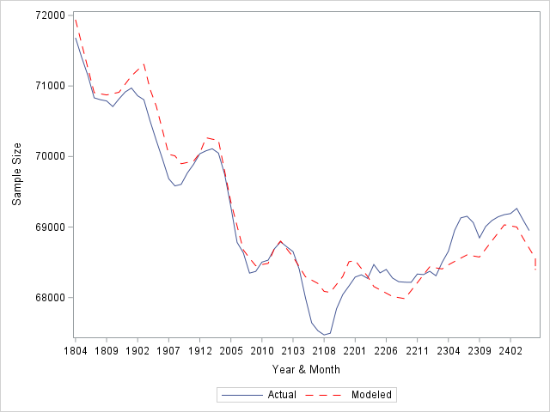
Comparison of Actual Sample Size to Modeled Sample Size over time
MODEL PREDICTS WELL UNTIL 2021
OVERPREDICTS DURING CALENDAR YEAR 2021 -- PANDEMIC
UNDERPREDICTS FROM THE BEGINNING OF 2022

Slide 18
Underprediction and MAF Improvements
MAF filters change after each decennial census
2020 MAF filters are FIRST applied to the MAF for samples chosen in 2022
The application of 2020 MAF filters REDUCES the number of Type C noninterviews, thereby reducing attrition

Slide 19
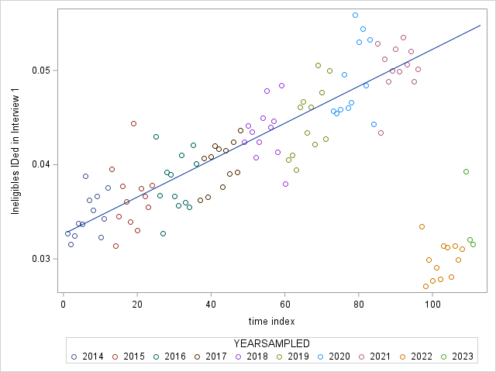
Type C noninterviews in the recent past
A SCATTERPLOT OF INTERVIEW 1 TYPE C NONINTERVIEWS versus TIME
THE Y AXIS IS THE PROPORTION OF LOADED SAMPLE THAT ARE INTERVIEW 1 TYPE C’S
THE X AXIS ARE THE NUMBER OF MONTHS SINCE APRIL 2014

Slide 20
Conclusions
The month to month variation in CPS sample size depends on the number of MAF additions that each panel has undergone
Account for changes in the growth of the sample frame (MAF) to predict the sample size.
Account for the effect of recent MAF filters to predict sample size

